Slide 1



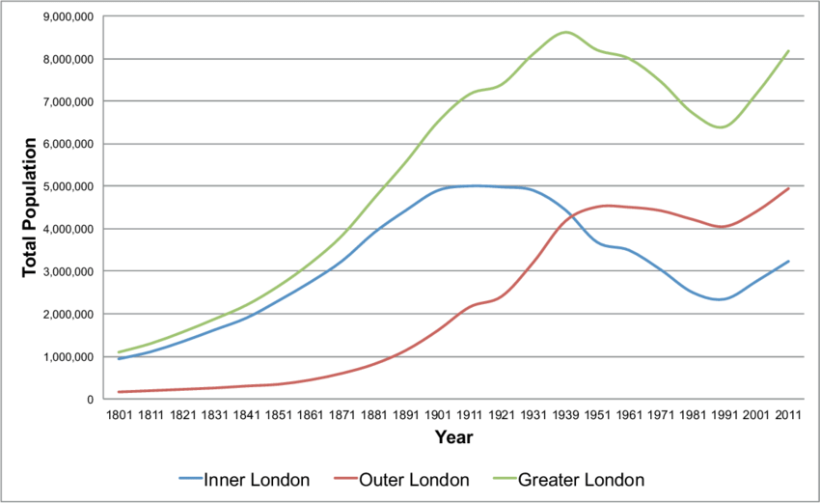
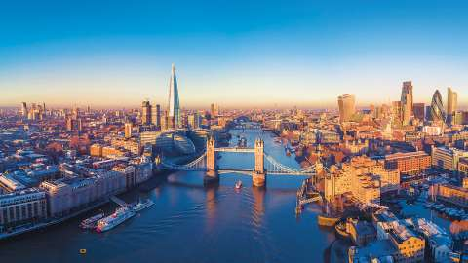
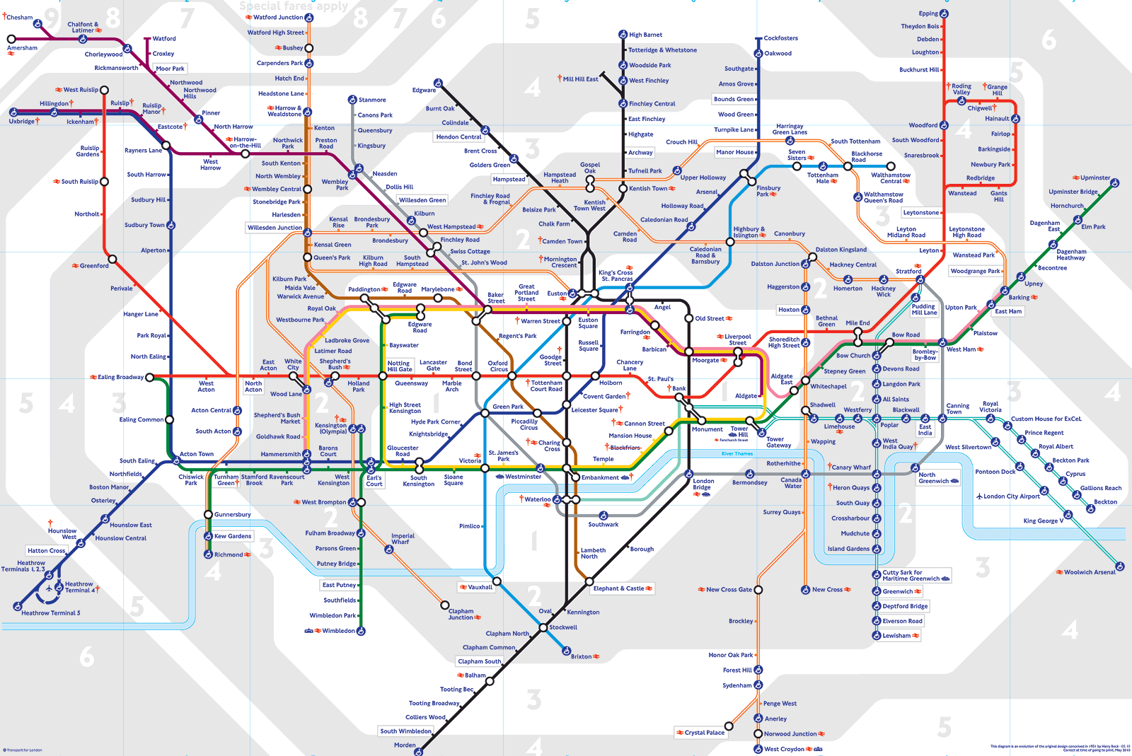

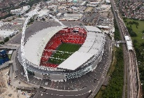
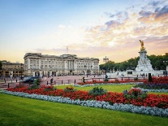
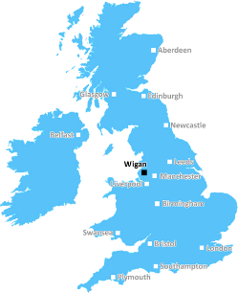
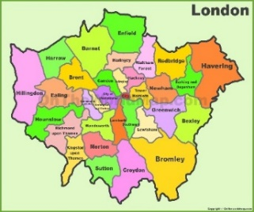
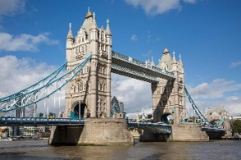
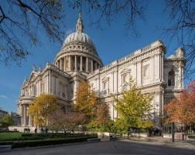
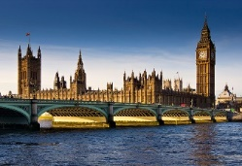
The ASPIRE Curriculum-Key Learning
Title: What is it like to live in London? Year: 6 Subject: Geography
Key Knowledge | Key Skills | Key Vocabulary
 | I can use 6 figure grid references to locate landmarks. I can use 8 points of the compass to locate places. I can locate key human and physical features in a place. I can explain how places have changed over time. I can compare locations using geographical vocabulary. I can use maps and atlases to focus on the geography of a city. I can use maps to plan a route.
Physical features | Human features
River Thames | landmarks
Prime Meridian | monarchy
borough | A town or area with it’s own representative in Parliament.
capital city | A city that has been identified as the location for the government.
climate | The usual weather conditions in a place.
commercial | Relating to trade or business.
Greenwich mean time | The solar time that is determined at the prime meridian through Greenwich, England, and that is used to calculate and regulate time throughout most of the world
population | The number of people living in a place.
landmark | A significant point or place in an area.
leisure | Free time or recreation
micro-climate | The climate of a small, specific, or partial area rather than that of the whole city.
Parliament | A group of people who make the laws for the country.
recreation | Free time or leisure.
settlement | A place where people have settled.
tourism | Travelling to new places for business and leisure.
urban | Relating to a city or town.
London’s population
London skyline
London underground map
London boroughs
Famous London landmarks

