Slide 1
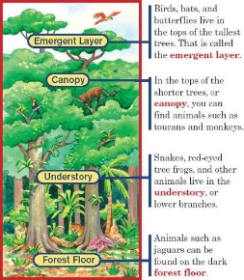
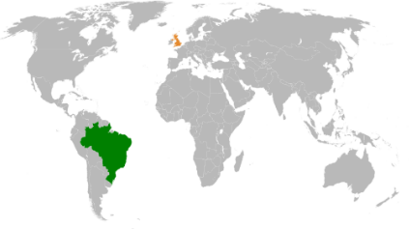
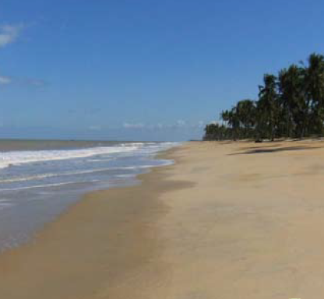
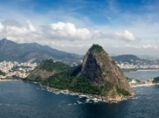
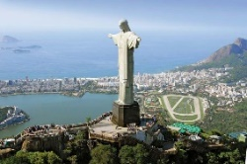
The ASPIRE Curriculum-Key Learning
Title: What is it like to live in Brazil? Year: 5 Subject: Geography
Key Knowledge | Key Skills | Key Vocabulary
 | I can use 8 compass points to locate places. I can use maps, globes and atlases to locate places. I can use geographical vocabulary to describe and compare locations. I can ask geographical questions. I can use 6 figure grid references to locate places on a map. I can describe the human and physical features in different locations. I can produce labelled diagrams.
 | Comparison
Country | Brazil | England
Continent | South America | Europe
Flag
Important river | Amazon River | River Thames
Mountain | Pico da Neblina Sugarloaf mountain | Scafell Pike
Population | 209.5 million | 56 million
Climate | Opposite seasons to the UK Weather is mostly the same all year in each part of the country Heavy rainfall in the Amazon | Summer: warm, sunny Winter: cold, wet. Sometimes snows
Amazon | The longest river in South America. It flows from the Andes mountains in Peru across northern Brazil to the Atlantic Ocean.
biome | A large community of plants and animals occupying a habitat.
coastline | The outline or shape of a coast.
deforestation | The process of cutting down trees in a forest.
endangered | Something that is put in a dangerous situation.
favela | A Brazilian shack or shantytown.
indigenous | Originating in a country or locality.
population | The people who live in an area.
rainforest | Forest which grows in hot, wet climates.
sub-tropical | The regions immediately north or south of the Tropics.
tribe | A group of people or villages that share the same language and traditions.
vegetation | The plants or plant life in a particular place.
Rainforest layers
Map of Brazil and UK
The country has five distinct areas of vegetation, reflecting the climate in each part.
1. Rainforest 2. Tropical grasslands
3. Semi-desert vegetation 4. Tropical forests
5. Subtropical grasslands
Physical geography human geography

