Slide 1
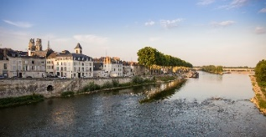
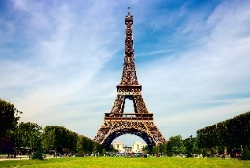
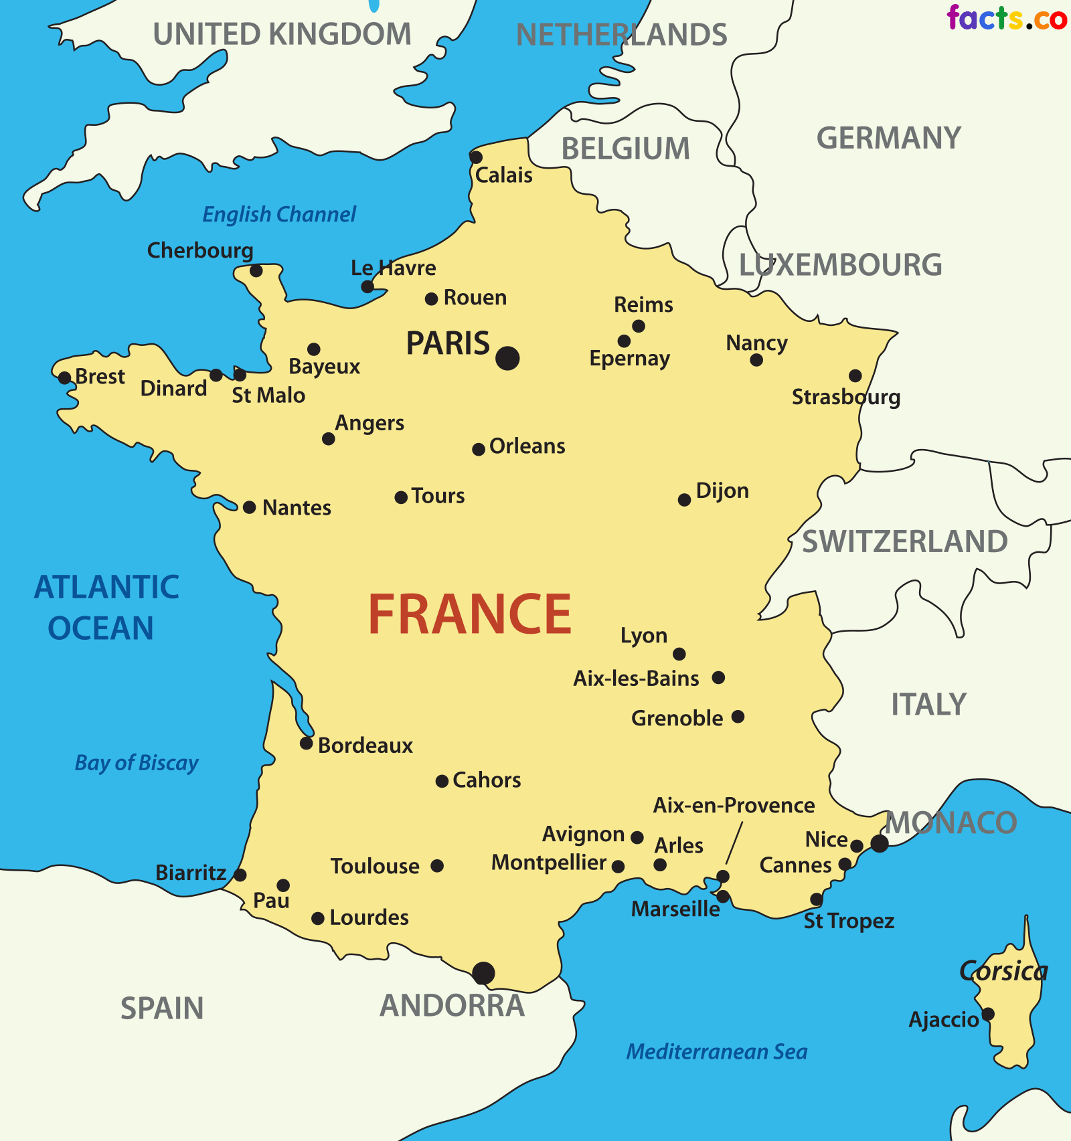
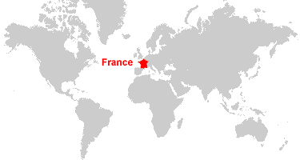
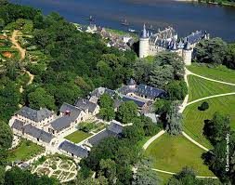
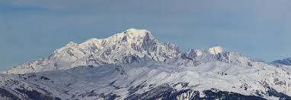
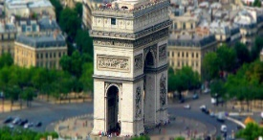
The ASPIRE Curriculum-Key Learning
Title: What is it like to live in France? Year: 3 Subject: Geography
Key Knowledge | Key Skills | Key Vocabulary
 | I can compare two locations. I can use pictures to find out about the physical and human features of a place. I can use maps, atlases and globes to locate places and their relation to the Equator and the Tropics. I can use geographical vocabulary to describe places. I can use the 8 points of a compass. I can ask and answer geographical questions.
 | Comparison
Country | France | England
Continent | Europe | Europe
Flag
Important river | River Loire | River Thames
Mountain | Mont Blanc | Scafell Pike
Population | 66.99 million | 56 million
Climate | Warm, dry. in Spring and Summer Wet during Autumn Mild winters | Summer: warm, sunny Winter: cold, wet. Sometimes snows
capital city | A city that has been identified as the location for the government.
climate | The usual weather conditions in a place.
continent | A large land mass. There are 7 continents in the world.
currency | The money used in a country.
Human geography | Features of a place, made by man, such as buildings, roads, houses.
landmark | A significant point or place in an area.
Mediterranean | Relating to the Mediterranean Sea, the countries bordering it, or the people living in those countries.
mountain range | A group of mountains that were formed during the same time period.
Physical geography | Natural features of a place, such as mountains, rivers and volcanoes.
population | The people who live in an area.
region | A large area of land.
tourism | Travelling to new places for business and leisure.
twin town | A town that has made links with another town in a different country.
Map of France and the UK
Aerial view of Chaumont
physical geography
human geography

