Slide 1
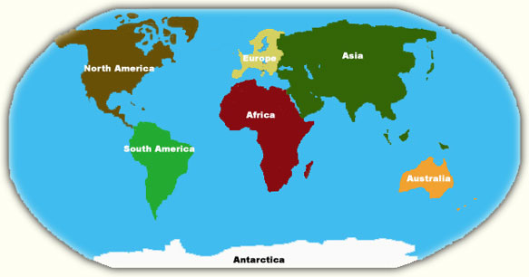
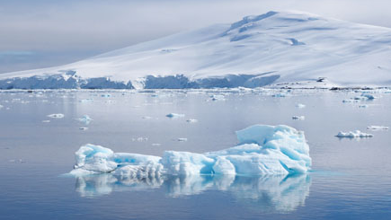
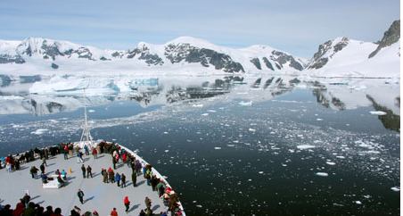
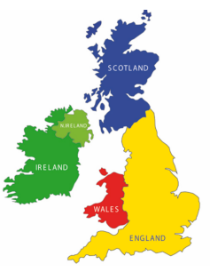
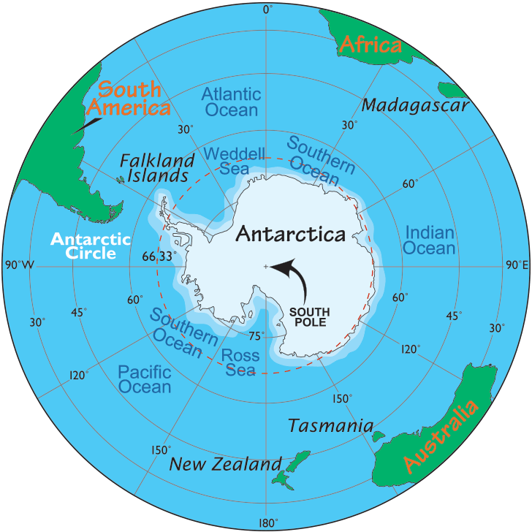
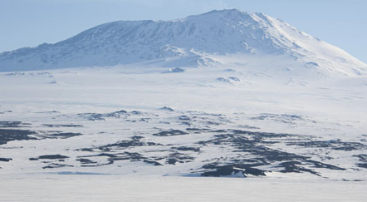
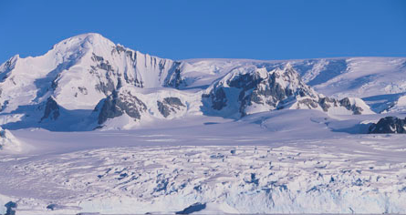
The ASPIRE Curriculum-Key Learning
Title: What is it like to live in Antarctica? Year: 1 Subject: Geography
Key Knowledge | Key Skills | Key Vocabulary
 | I can make comparisons between places. I can describe places using geographical vocabulary. I can locate places using globes, maps and atlases. I can use the 4 points of the compass. I can use photographs to recognize key human and physical features. I can ask and answer questions about a place. I can observe and record the weather and temperature in two different places.
 | Comparison
Country | Antarctic | England
Continent | Antarctica | Europe
Flag
Important river/lake | Lake Vostok | River Thames
Mountain | Vinson Massif | Scafell Pike
Population | 2,000 (temporary) | 56 million
Climate | Summer: Cold, dry, windy, Winter: cold | Summer: warm, sunny Winter: cold, wet. Sometimes snows
Antarctic | A polar region around the South Pole.
Antarctica | A continent at the Southernmost part of the world.
Blizzard | A severe snowstorm with high winds.
Continent | A large land mass. There are 7 continents in the world.
Glaciers | A slow moving mass or river of ice.
Icebergs | A large floating mass of ice from a glacier or ice sheet.
Mountains | A large natural rise from the Earth’s surface.
Southern Ocean | One of the 5 oceans of the world.
South Pole | The Southern location on the Earth, where the Earth rotates.
Volcanoes | A mountain or hill, where molten rock erupts through the surface of the Earth.
Physical features - Antarctic
Mount Erebus | Transantarctic mountains

