Slide 1
Education Swimming Pupil Preparation
Nicola Lawton – Head of Aquatic and Gymnastic Courses

Slide 2

School Swimming
School Swimming will begin on Friday 9th January 2026

Slide 3
Starting School Swimming Lessons

Slide 4
Welcome to Active Tameside School Swimming
You may be feeling anxious – that’s totally understandable
For some of you it will be the first time you have been to swimming lessons.
For others you will have had swimming lessons already.
Don’t Worry
When you arrive at the pool our swimming teachers will go through all the safety procedures and then do an assessment of your swimming.
The Swimming teachers may put a swimming aid on you initially, even though you may be able to swim. This is to make sure you are safe. Once the teachers have done their assessment you will be placed in your ability group and the aid may be removed?

Slide 5
How you can help us?
Your school swimming lessons will be fun but we need you to remember a few things:-
Always remember your swimming kit – you can’t swim without it.
Always remember to stay safe – do not leave your group once you come into the centre.
Always use your listening ears – your swimming teacher will give you a lot of information, swimming pools are quite noisy and if you don’t listen carefully, you may miss important instructions.
Always walk in the centre – there will be members of the public in the communal areas and poolside will be wet and slippy.
Always act sensibly – we know it is exciting to be in the pool, but it is a lesson just like those in school.
Always let us know if you feel unwell.
Always remember you are representing YOUR school.

Slide 6
How will we help you?
Our swimming teachers' number one priority is to keep you safe
They will show you where to change
They will tell you where the toilets are
They will point out the fire exits
They will go through your pre pool hygiene
They will show you where to leave any medication you might need when at the pool
They will show you where to wait for your lesson
Most importantly they will help you feel safe so you can learn to swim.

Slide 7
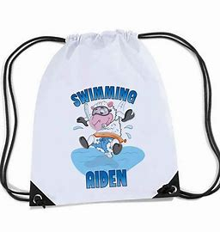
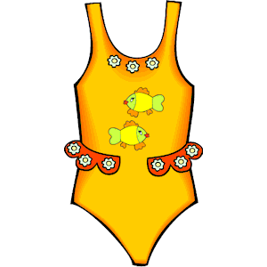

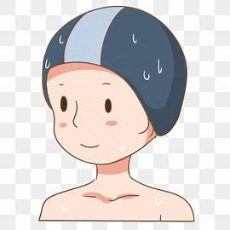
what I need to bring ?
Swimming bag
Girls – swimming costume
1 piece Costume or Burkini (no bikini/tankini)
Optional fitted leggings and rash vest for modesty
Swimming cap – this helps to stop your hair
falling in your face and mouth, which can
Cause choking
Minimum - long hair
tied up
Towel

Slide 8
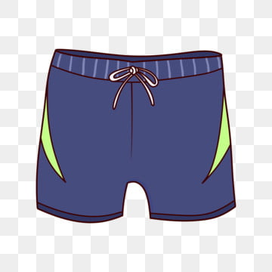
what I need to bring ?
Swimming bag
Boys – swimming trunks/shorts (must have internal netting)
mid thigh length (no Bermuda/fashion shorts)
Optional fitted leggings and rash vest for modesty
Swimming cap – this helps to stop your hair
falling in your face and mouth, which can
Cause choking
Minimum - long hair
tied up
Towel

Slide 9
Getting to the pool

Slide 10


How will we get there ?
If your school is very close to our pool, you may walk
Other schools may need to come on a bus/coach

Slide 11
Arriving at the pool

Slide 12
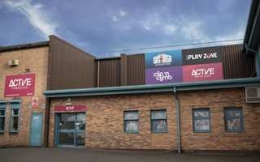
arriving at Active Medlock
Please be considerate and remember members of the public also use our centers.

Slide 13
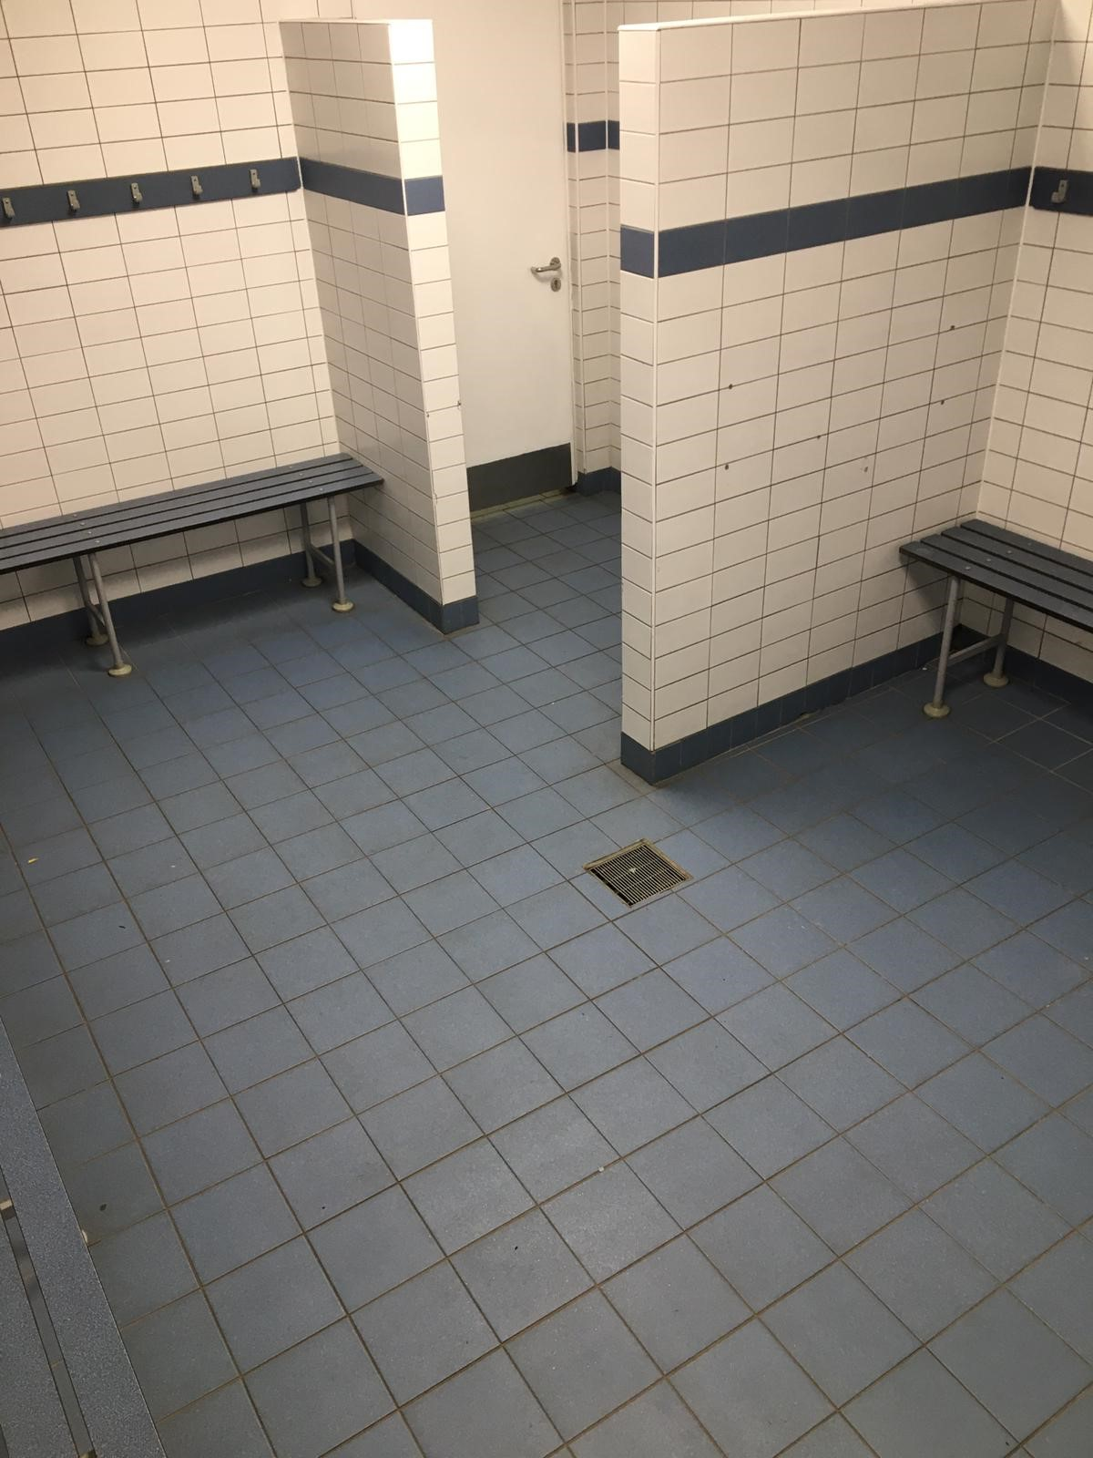
Group Change
For school swimming we use group changing rooms.
There is one for boys and one for girls.
Find a changing space and place your bag on the hooks. Get changed as quickly as possible and line up outside your changing room with your teacher.
Once everyone is ready to go into the pool hall your teacher will lead you through the shower area.
Please visit the toilet before attending your swimming lesson

Slide 14
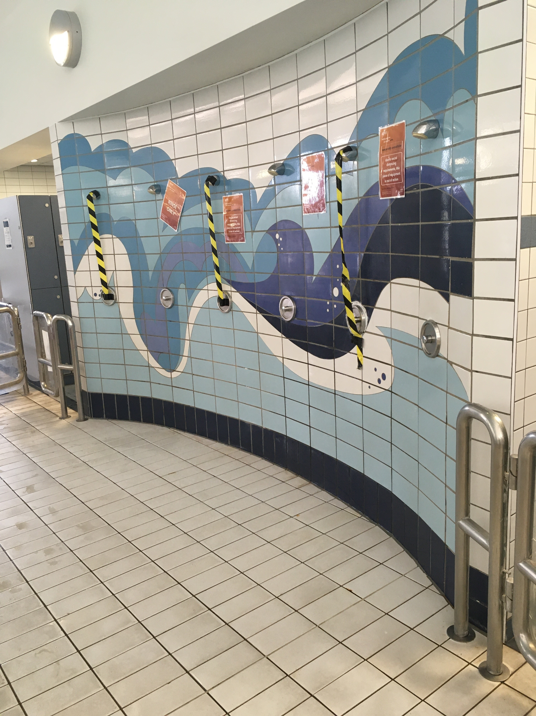
Pre Cleanse
Before getting in the pool you must shower, this helps keep the pool clean.

Slide 15
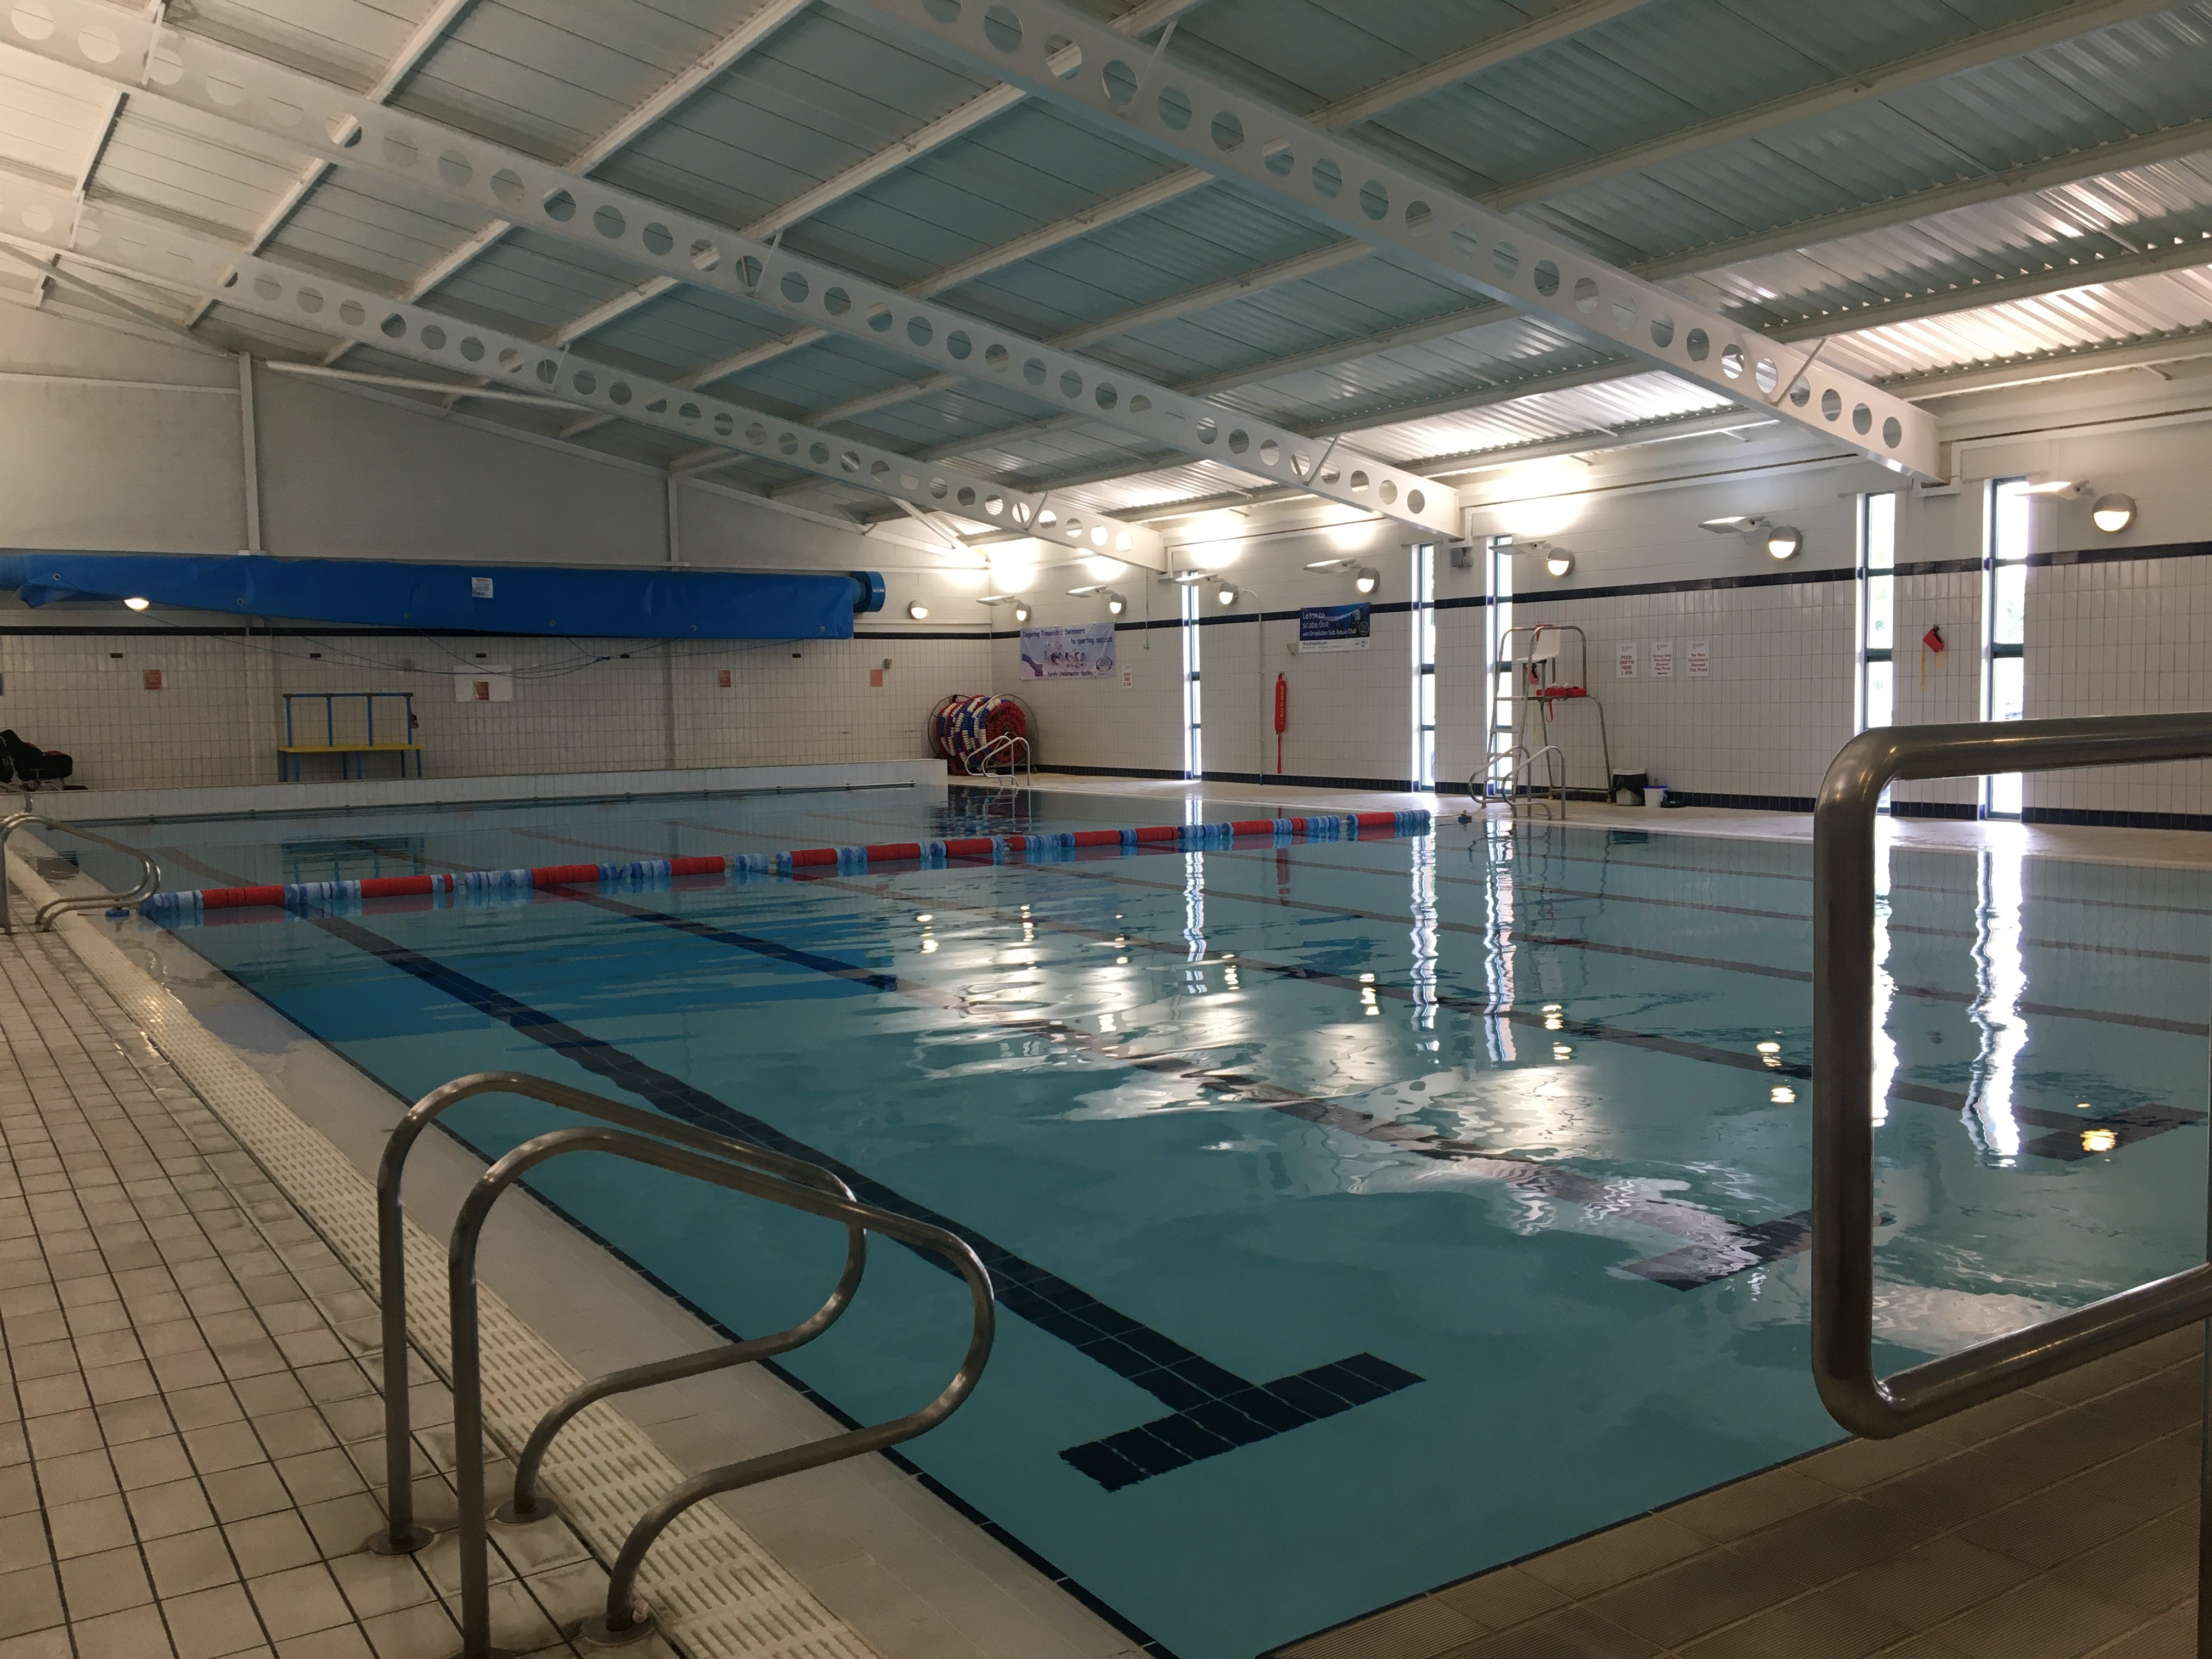
Pool Hall
We have one pool at Active Medlock

Slide 16
Pool hall behaviour

Slide 17
Protect yourself and respect others
We ask you to protect yourself by;
Acting sensible
Following instructions
Walking around poolside
Listening to the teachers, not talking when they are talking
Wearing the swimming aids your teacher selects
We ask you to respect others by;
Remembering it is a lesson
Respecting everyone has different abilities
Show kindness and patience to your classmates

Slide 18
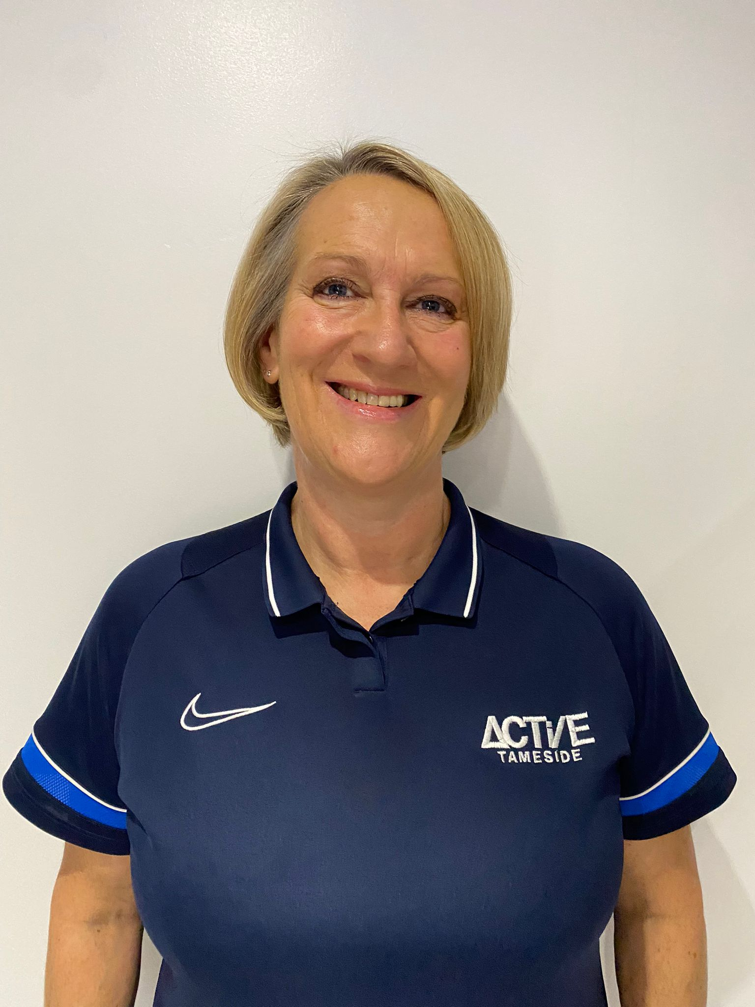
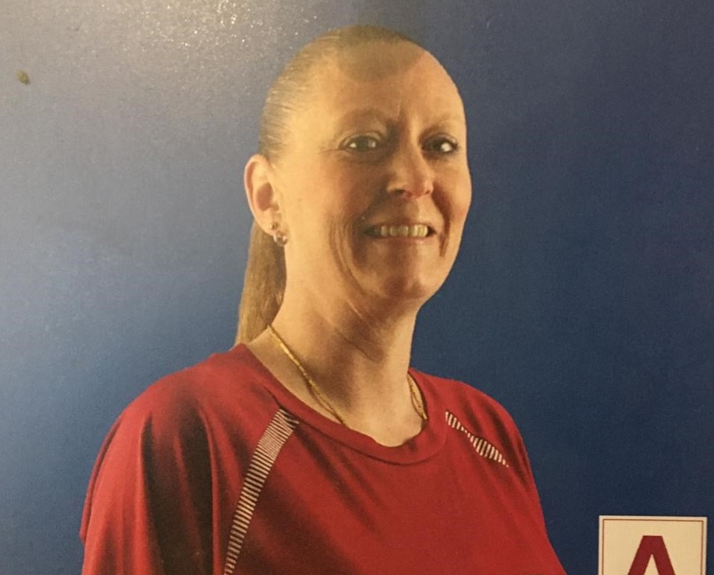
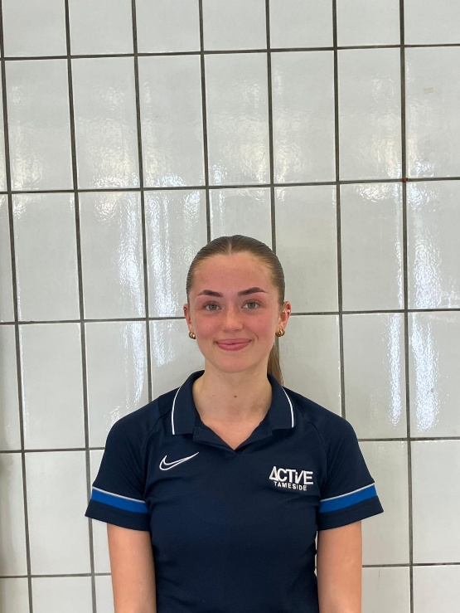
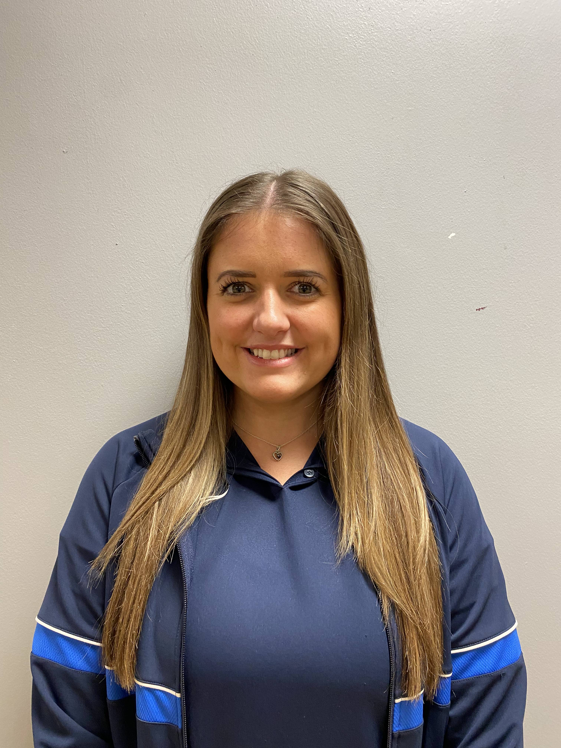
Welcome
We can’t wait to see you
Lindsey
Sophie
Claire
Amy
?????

